Slide 1

ENSURING A NATIONAL POLICY FRAMEWORK FOR ARTIFICIAL INTELLIGENCE
Week of March 30
Jacob Appling

Slide 2
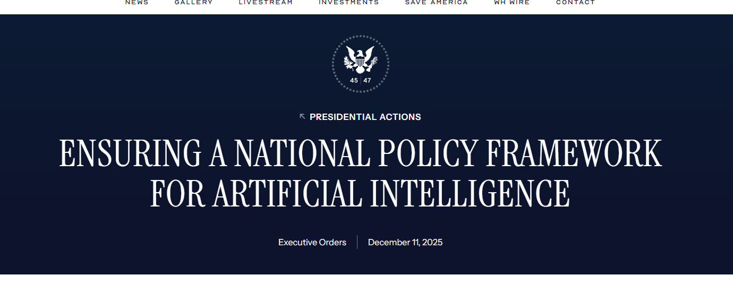
Article #4 (Row 4 via Google Sheet)

Slide 3
Link to the Source
https://www.whitehouse.gov/presidential-actions/2025/12/eliminating-state-law-obstruction-of-national-artificial-intelligence-policy/

Slide 4
Main Findings
The order says the U.S. is in a strategic competition for AI leadership and must reduce barriers to innovation.
It criticizes state-by-state AI regulation as creating a confusing patchwork of rules that makes compliance difficult.
It argues some state laws may force AI systems to change or suppress truthful outputs, which the order frames as ideological bias or even deceptive conduct.
It creates an AI Litigation Task Force in the Justice Department to challenge state AI laws seen as inconsistent with federal policy.
It directs the Commerce Department to review state AI laws and identify ones considered too burdensome.
It also proposes using federal funding pressure by limiting some grants or broadband-related funds for states with disfavored AI laws.
The order pushes toward future federal legislation that would preempt conflicting state AI laws, while still allowing states to regulate some areas like child safety, AI infrastructure, and state government use of AI.

Slide 5
Broader implications for society
It signals a strong shift toward federal control over AI policy, reducing the power of individual states to set their own rules.
Supporters would likely argue this could speed up innovation, attract investment, and help the U.S. compete globally.
Critics would likely worry it weakens protections against harms such as bias, misinformation, privacy violations, and lack of transparency.
The order suggests a tension between innovation and regulation: it prioritizes economic growth and global competition over more cautious oversight.
It may increase legal and political conflict between federal and state governments, especially around constitutional questions like interstate commerce and free speech.
Society could see faster AI deployment, but potentially with fewer local safeguards unless Congress creates a balanced national framework.

Slide 6
Relevance and potential influence on the construction industry
A lighter national AI framework could make it easier for construction firms to adopt AI tools across multiple states without dealing with different state regulations.
Large contractors, consultants, and software vendors could benefit from more uniform rules when using AI for scheduling, estimating, clash detection, risk analysis, document review, and project controls.
Startups in construction tech may find it easier to scale AI products nationally if compliance becomes simpler.
AI adoption in areas like predictive maintenance, jobsite monitoring, workforce planning, procurement, and BIM-related analytics could accelerate.
On the other hand, fewer state restrictions could raise concerns about accountability if AI tools make flawed recommendations related to safety, hiring, design coordination, or cost forecasting.
For owners and contractors, the order may encourage broader experimentation with AI, but it may also create uncertainty until federal standards are fully defined.

